Slide 1
STATISTICAL INFERENCE
Lab 8

Slide 2
Hypothesis Testing
A statistical hypothesis is an assumption about a population parameter.
This assumption may or may not be true.
Hypothesis testing refers to the formal procedures used by statisticians to accept or reject statistical hypotheses.

Slide 3
The basic concept of hypothesis testing is to form an assertion and test it with data
• Null hypothesis (H0) :There is no difference
• Alternate hypothesis (H1) :There is a difference

Slide 4
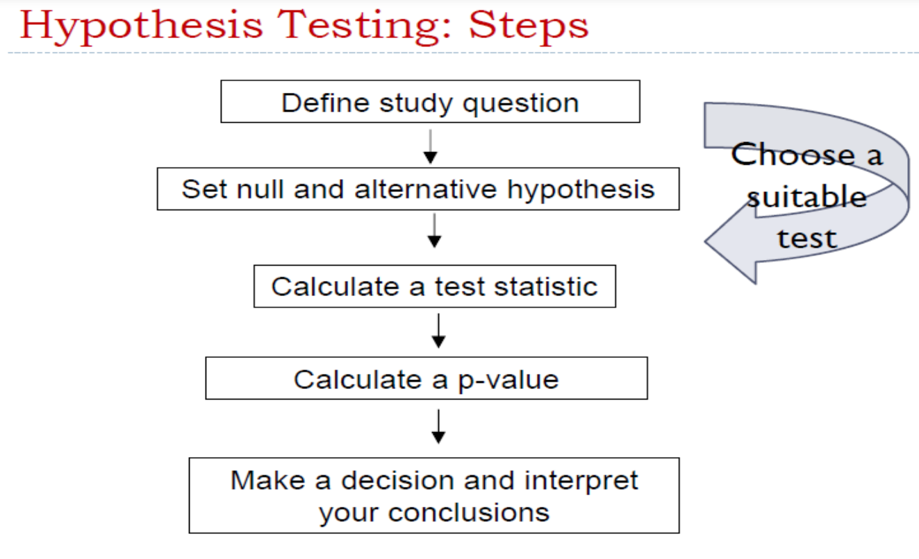

Slide 5
Statistical Hypothesis Testing:
1. T- Statistics :
1.1 Student t-statistic
1.2 Welch t-statistic

Slide 6
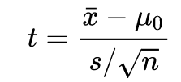
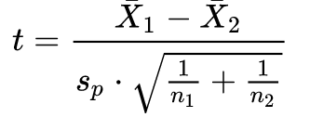
One-sample t-test. in lecture
Equal or unequal sample sizes, similar variances (1/2 < s_{X1}/s_{X2} < 2)

Slide 7
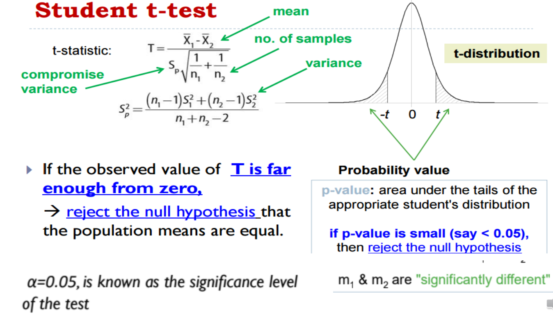

Slide 8
Create a function to calculate the pooled variance, which is used in the Student’s t statistic:
> x = rnorm(10) # distribution centered at 0
> y = rnorm(10,2) # distribution centered at 2
> pooled.var = function(x, y) {
nx = length(x)
ny = length(y)
stdx = sd(x)
stdy = sd(y)
num = (nx-1)*stdx^2 + (ny-1)*stdy^2
denom = nx+ny-2 # degrees of freedom
(num/denom) * (1/nx + 1/ny) }

Slide 9
Examine the data
>mx = mean(x)
0.05536668
>my = mean(y)
1.873915
>mx – my
1.929281
>pooled.var(x,y)
0.2574688

Slide 10
Calculate the t statistic for Student's t-test:
> tstat = (mx - my)/sqrt(pooled.var(x,y))
> tstat
- 3.802185

Slide 11

Perform Student’s t-test :
> x = rnorm(10) # distribution centered at 0
> y = rnorm(10,2) # distribution centered at 2
>t.test(x, y, var.equal=T)
data: x and y
t = -3.9582, df = 18, p-value = 0.0009217
Notes:
normally distributed data

Slide 12
Perform Welch t-statistic:
> x = rnorm(10) # distribution centered at 0
> y = rnorm(10,2) # distribution centered at 2
>t.test(x, y, var.equal=F)
data: x and y
t = -3.9582, df = 14.773, p-value = 0.001297
Notes:
not normally distributed

